Slide 1
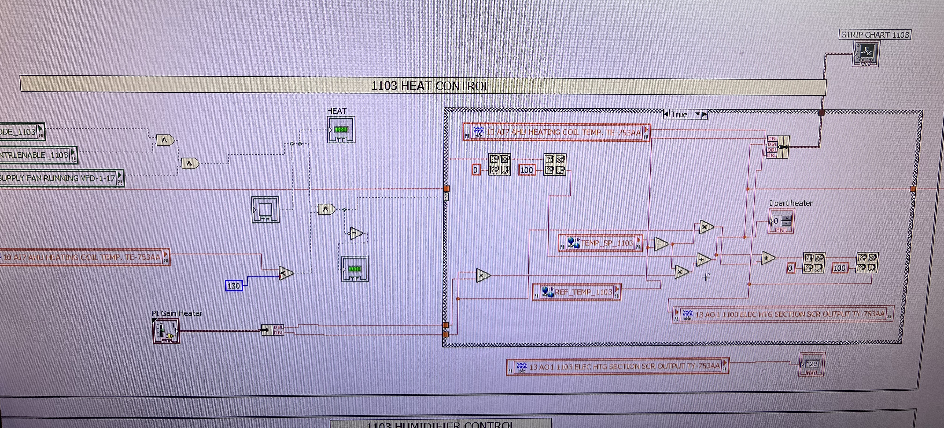
PI control for Heater in Psychrometric Chamber

Slide 2
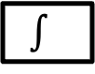
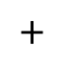
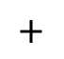
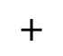
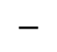
PI control for Heater in Psychrometric Chamber
P = 10, I = 0.0015
$$+$$
$$+$$
P
Heater
$$−$$
$$+$$
$$∫$$
PI

